Slide 1
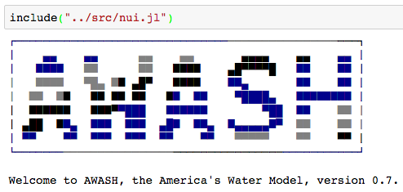
Modeling Overview

Slide 2
Describing the model
Contents:
Describing the model (too much?)
Examples of its use (4 projects)
How to help out (8 projects)

Slide 3
Model objective
Explore interactions between water, food and energy systems from a national perspective
In response to specific types of climate changes
In response to economic factors
GDP growth rate , Global Energy prices, Global Food demand
Investment climate – financing, rates, private vs public action
In response to demographic factors
Migration, Age distribution, income ….
In response to property rights models – water rights /others
In response to conservation technologies
In response to energy policy – renewables, carbon tax, biofuels etc
In response to agricultural policy or diet preferences – crop insurance etc
In response to political shifts and movements

Slide 4
Scalable Network Models of US Water Energy-Food-other resources
Design Decisions:
Modeled at a county-month scale for whole US
Network of interactions
Counties to neighboring counties
Other transport networks (water, electricity)
Treat arbitrary “resources”: water, energy, agricultural products
Solve for production, imports and exports, storage, prices
Interested in spatiotemporal optimization
Short-term optimization of production distribution
Long-term optimization of capacity expansion
Multiple objective functions to consider

Slide 5
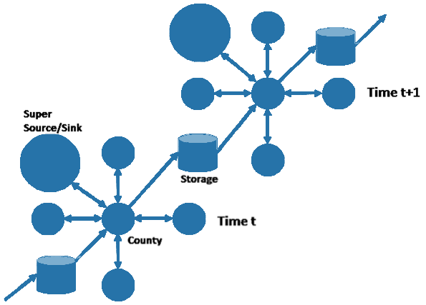
Model Space and Time

Slide 6
An integrated modeling framework
Component-based framework (Mimi in Julia)
Inputs from outside the model:
Inputs from other components:
Inputs from optimization:
Able to validate components individually and swap them out and have multiple variants.
Existing Mimi components for climate, biodiversity, disease, conflict, natural disasters
Linear programming optimization (Gurobi)
Automatic construction of LP matrices
Weather
Yields
Agriculture
Component
Fertilizer
Irrigation
Costs

Slide 7
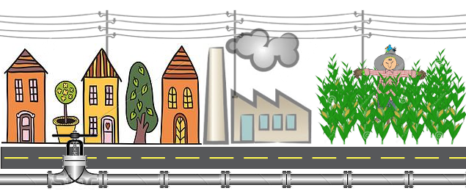
Model Elements
Populations: consume water, electricity, food
Power plants: consume water, biofuels; produce electricity
Agriculture: consume water, energy; produce food, biofuel
Water: consume energy

Slide 8
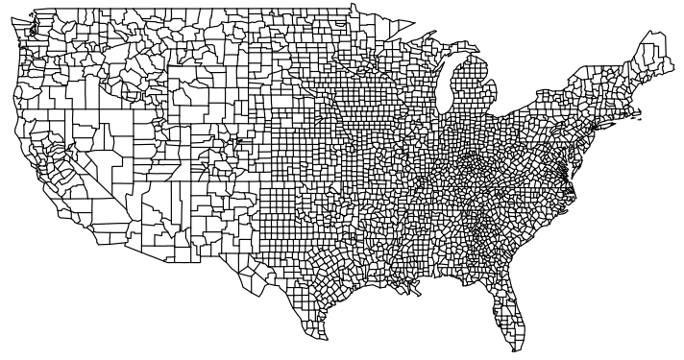
Basic model scale
Monthly, 1949 – 2009, and climate futures

Slide 9
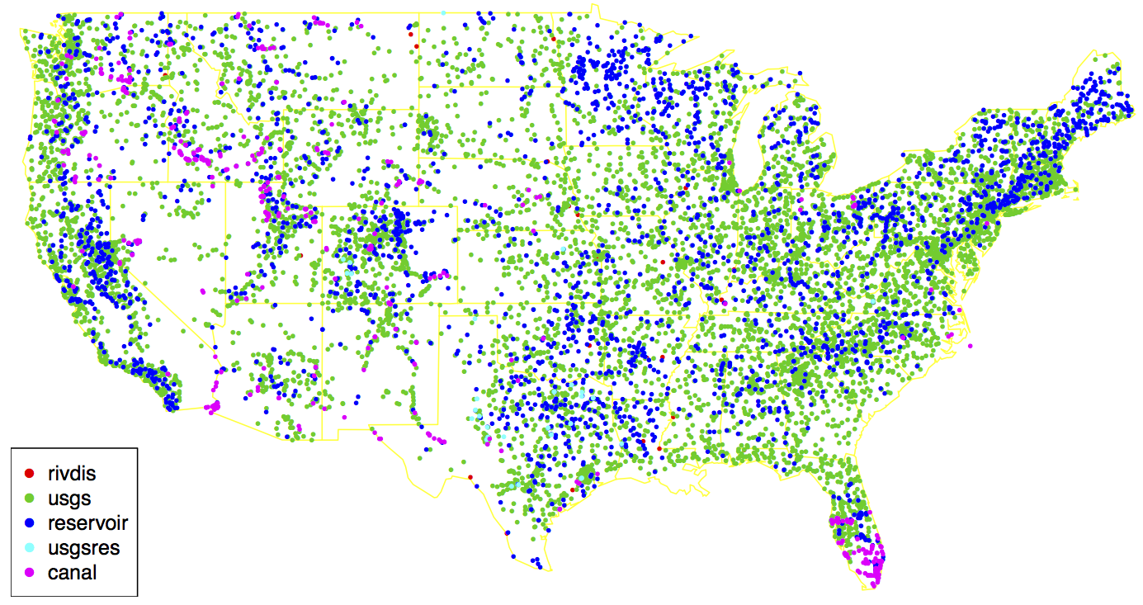
Flow Gauges, Reservoirs, Cross-border canals

Slide 10
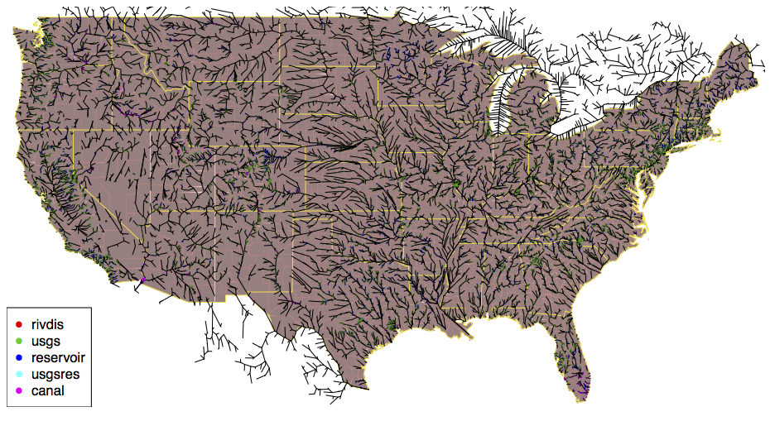
County River Network

Slide 11
County Transportation Network

Slide 12
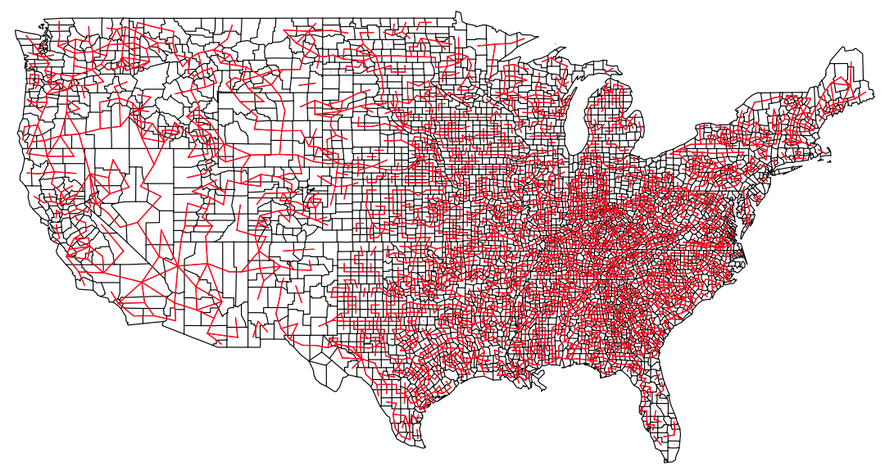
Electricity grid
County-level representation of TIGER high-voltage lines

Slide 13
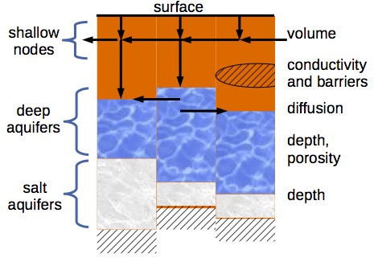
Groundwater Network

Slide 14
An stylized model element
A value-of-water optimization
Maximize total producer profits, assuming fixed prices and costs, realistic water supply, and an omnipresent market.
Water
Production
Production
Revenue
X
Product Price
Surplus
d dWater
MVoW
X
⁻
Extraction Cost

Slide 15
Adding distribution and demand
Determine the best locations for production and consumption, given demand.
Water
Production
Production
Distribution
Production
X
Revenue
Product Price
X
⁻
Surplus
d dWater
MVoW
Extraction Cost
Prices
Demand
Model
Consumption

Slide 17
Examples of analyses
Contents:
Describing the model (too much?)
Examples of its use (4 projects)
How to help out (8 projects)

Slide 18
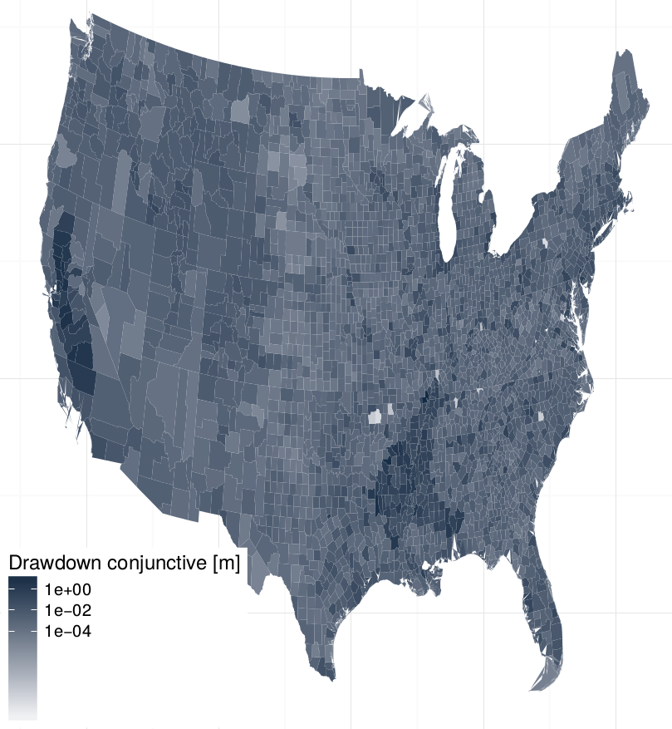
Current drawdown
Accounting for surface water and reservoirs

Slide 19
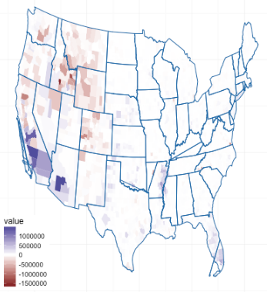
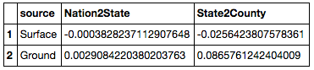
Effects of optimization
Hold all water demands constant
Minimize costs to satisfy demands over
Where to withdrawal from surface
Where to withdrawal from groundwater
When to release from reservoirs
Less GW
at state
More GW
USGS GW minus optimal GW

Slide 20
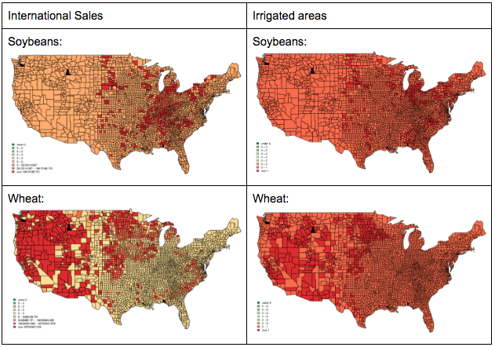
Allocation of agriculture

Slide 21
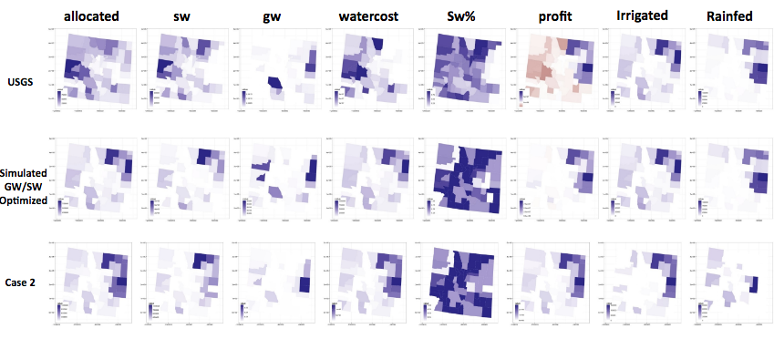
Colorado Case Study

Slide 22
Getting involved!
Contents:
Describing the model (too much?)
Examples of its use (4 projects)
How to help out (8 projects)

Slide 23
Our user interface
(Almost) self-installing interface:

Slide 24












Documentation!
Components | Tutorials
Agriculture | Simulation
Groundwater | SW optimization
Allocation | Network data
WaterNetwork | Unmodified flows
ReturnFlows | Installation
Reservoir | Contributing

Slide 25
We need help!
Website
Electricity Grid
Brewery
Automatic LP checking
Cross-state compacts
Biofuels
Environmental flows
Investment under political parties and local feedback

Slide 26
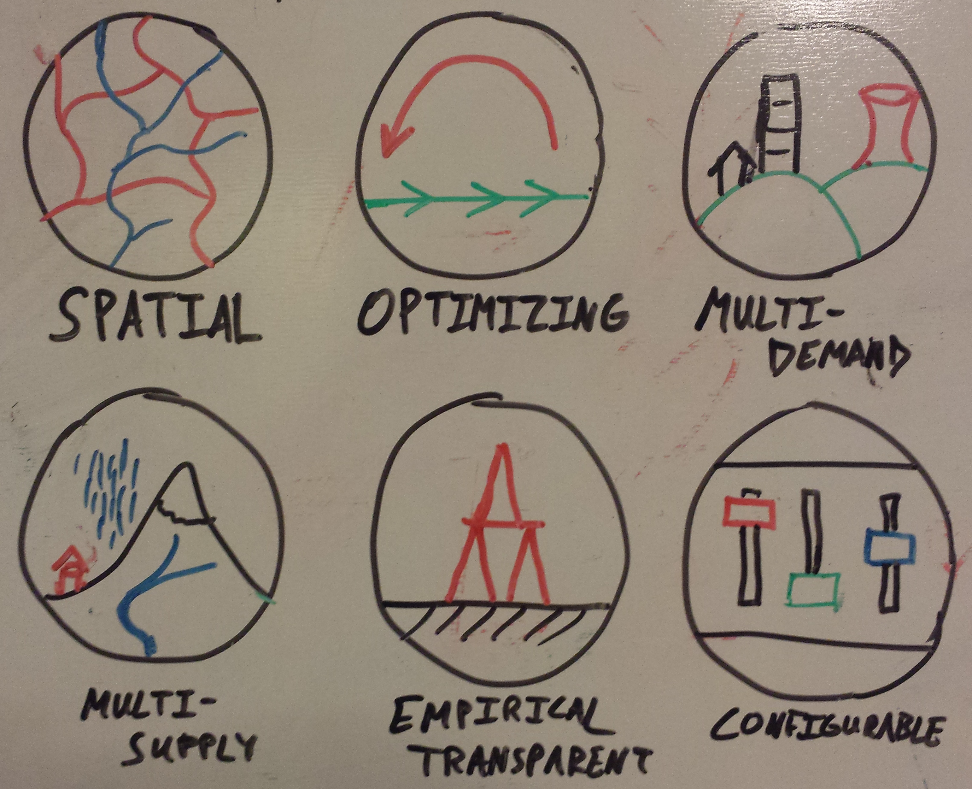
A Website

Slide 27
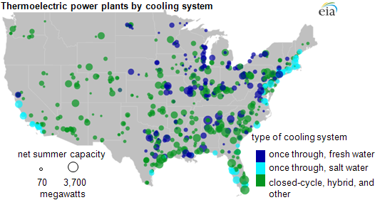
Electricity Grid

Slide 28
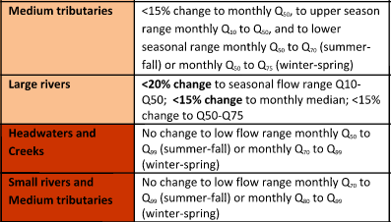
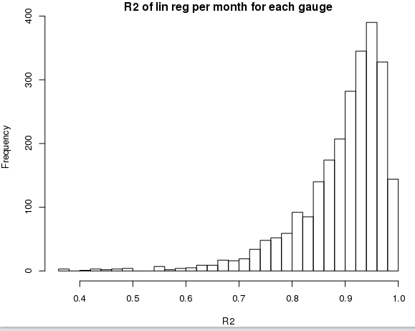
Implementing environmental flows
Unmodified monthly flows from VIC
Recommendations follow flow-duration curve
Monthly to daily quantiles linear

Slide 29
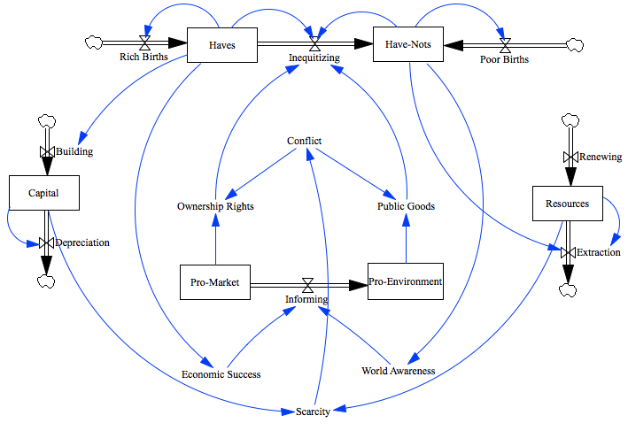
Political modeling

